Slide 1
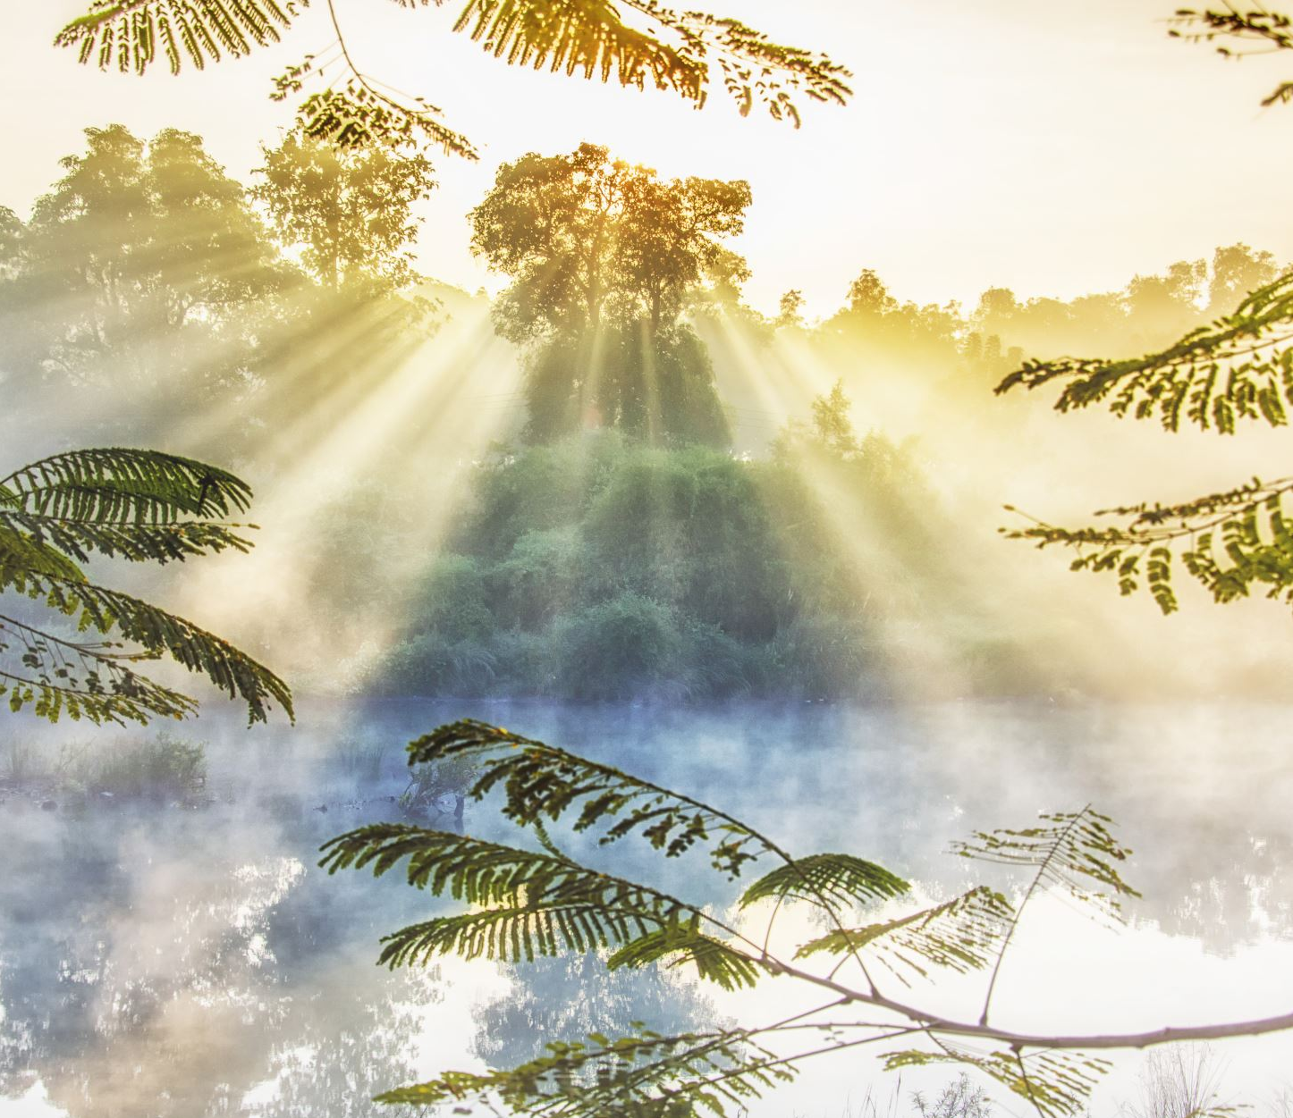
Sunlight’s Effect on an Ecosystem
Ebraheem Khalife, Julian Nouheid, Antony Moukheiber

Slide 2
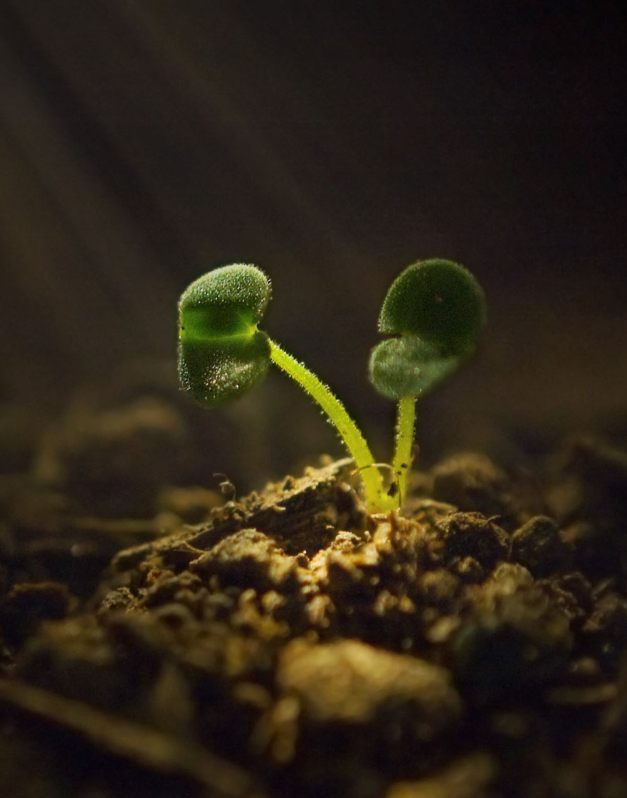
Purpose
- Experiment purpose: Investigate the impact of sunlight on the biotic and abiotic components of an ecosystem, specifically plant growth.
- Method: Use mesocosms (controlled miniature ecosystems) with varying levels of sunlight exposure.
- Measurement: Observe and measure the growth and behavior of plants within the mesocosms.
- Goal: Gain insights into the ecological impacts of changes in solar radiation.
- Implications: Findings could have important implications for the management and conservation of natural ecosystems.

Slide 3
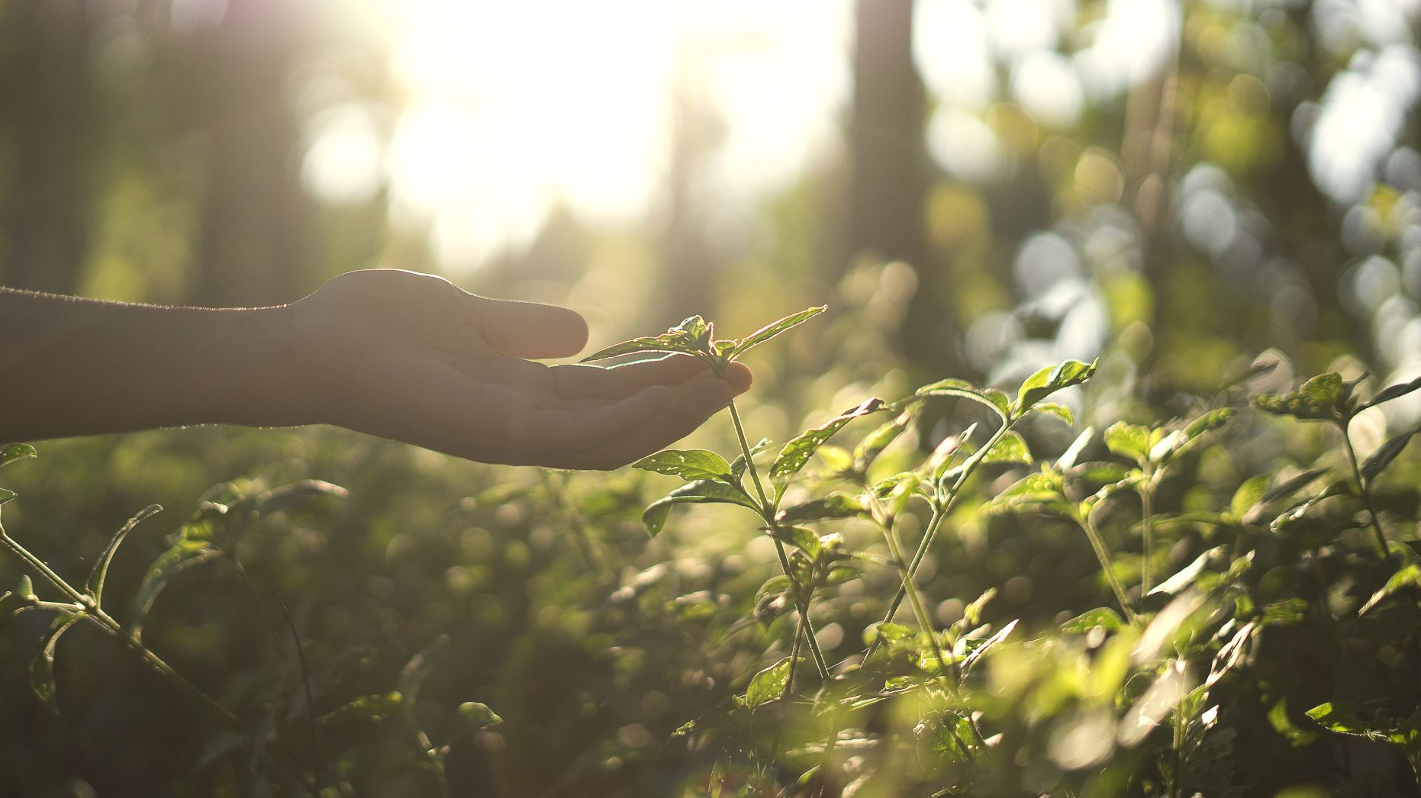
Hypothesis
If the sunlight reaching the mesocosm increases, then growth of the plants will increase?

Slide 4
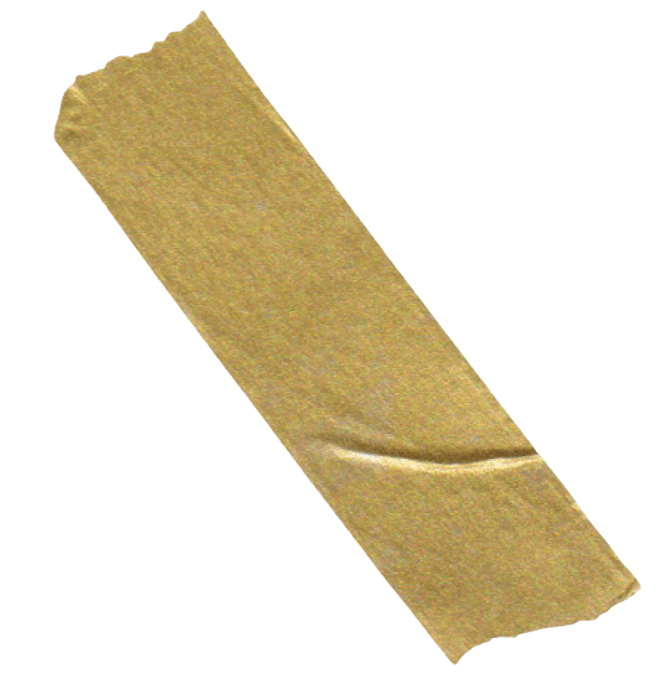
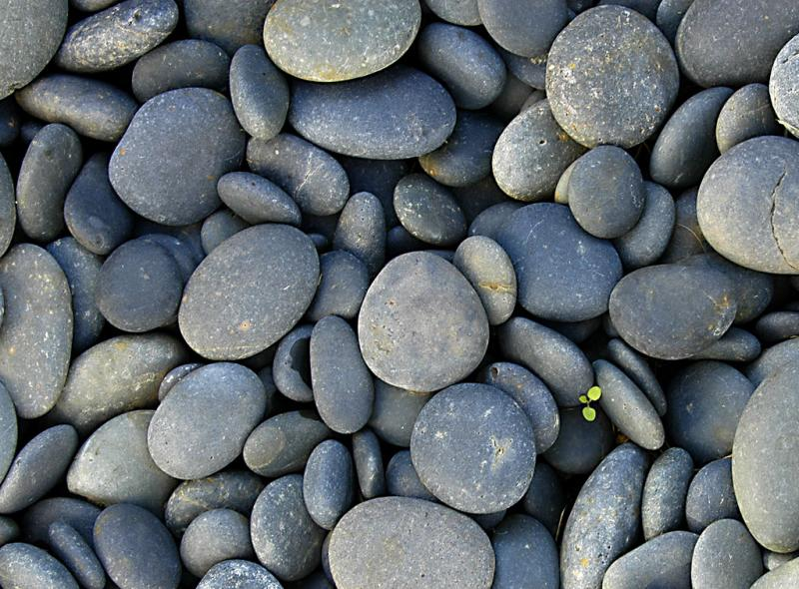
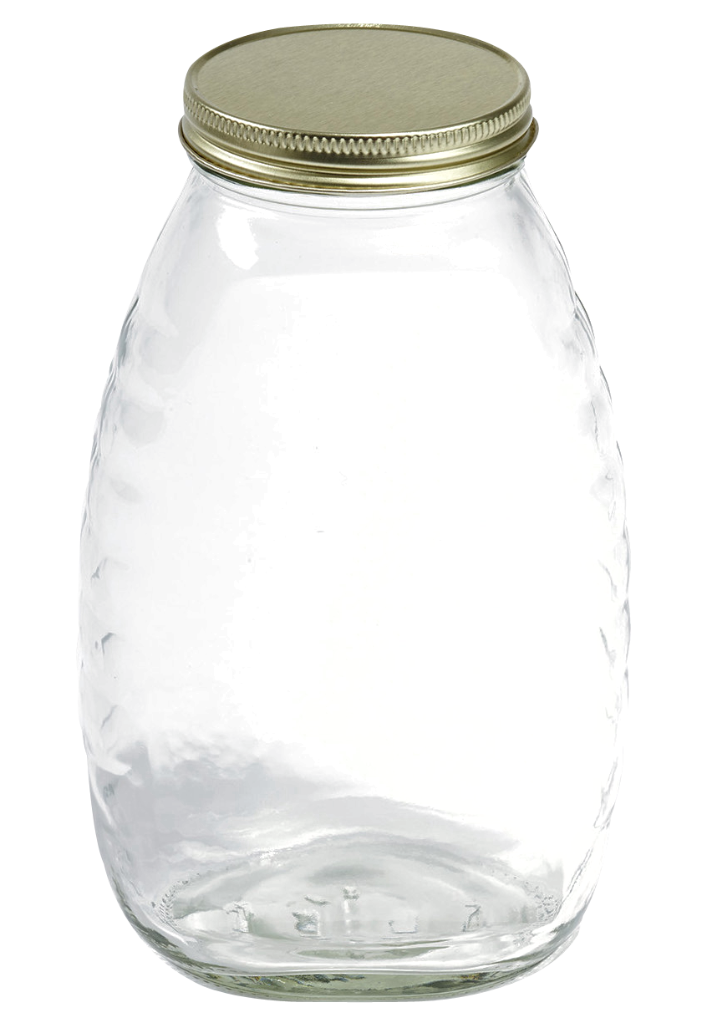
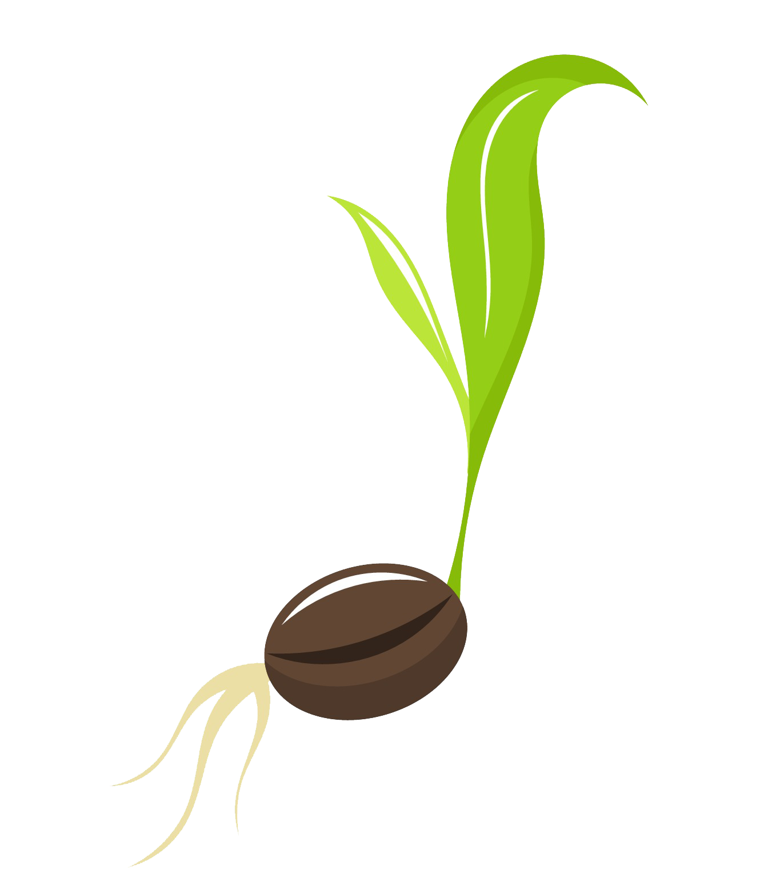
Materials
A large jar with lid.
Small stones/pebbles.
Soil
plant seeds
Measuring tape/ruler

Slide 5
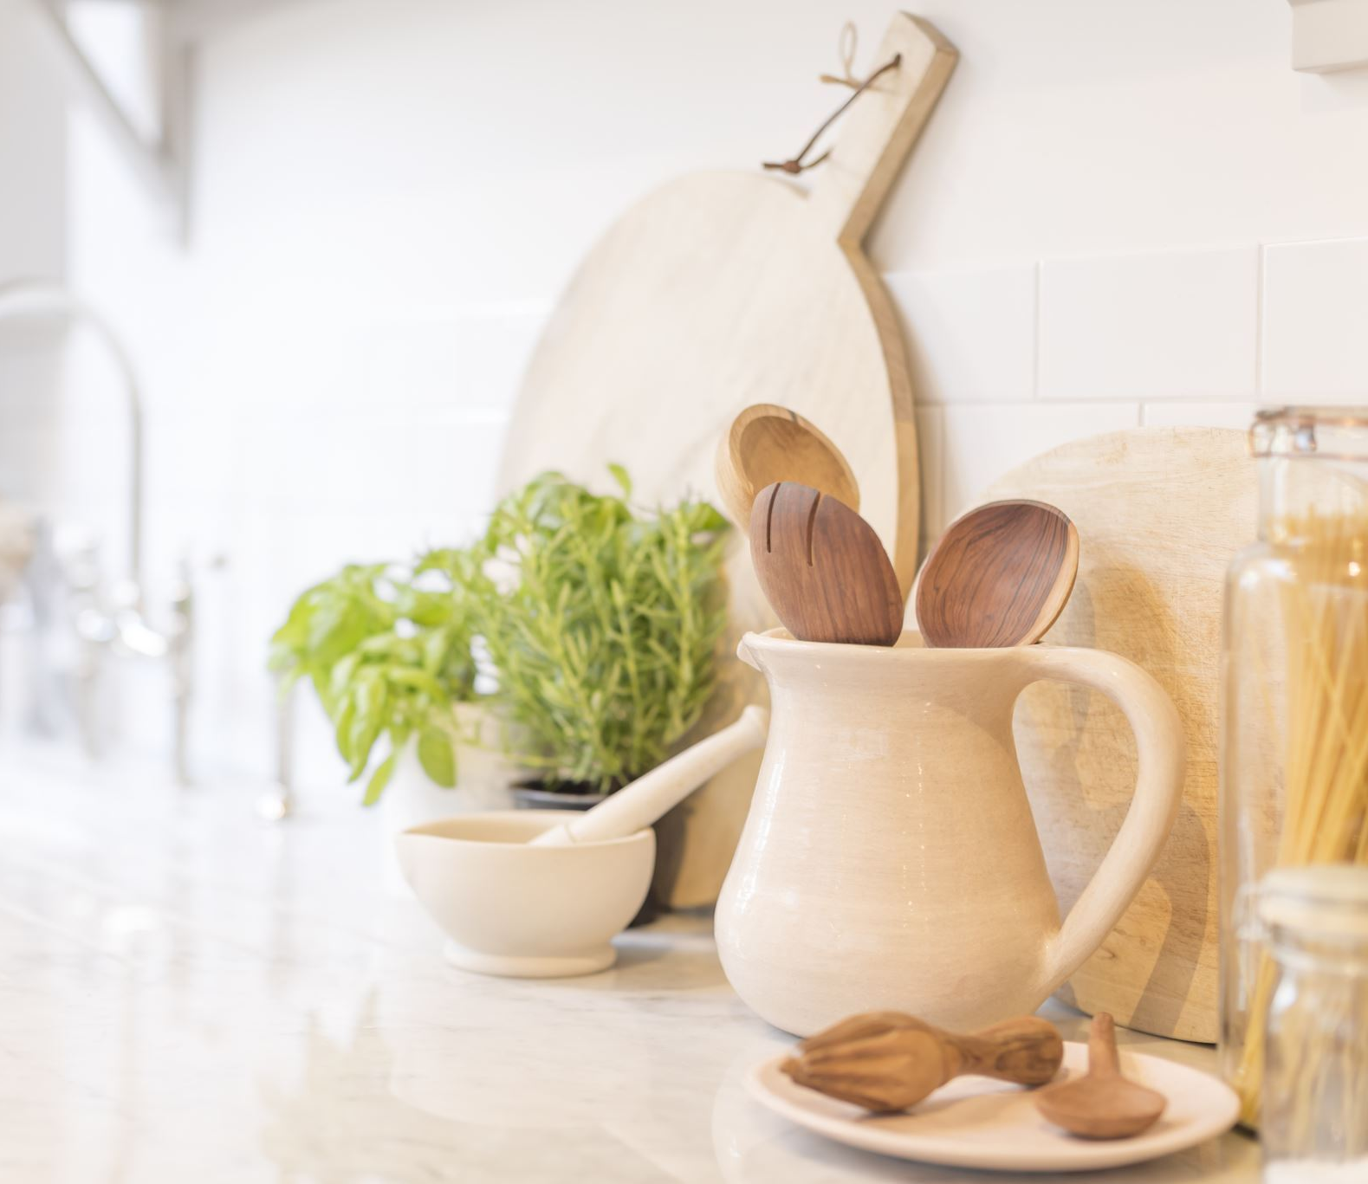
Procedure
Prepare an empty jar and place small stones at the bottom.
Pour soil in the jar until about 2/3 of the jar is full
Place the seeds in, then add a little bit more soil just enough to cover the seeds
Cover the mesocosm with a lid or plastic wrap to prevent evaporation and contamination
Place the mesocosm in a closed room next to a window, in an area clearly allowing sunlight to reach it.
Record the plant growth with a measuring tape after 1 week
Repeat steps 1-6 for another mesocosm, except now place the mesocosm in an area where sunlight can’t possibly reach it. Make sure this mesocosm is in the same room as the other mesocosm to keep the temperature the same.

Slide 6
Variables
Controlled Variable | How it’s controlled | Why it’s controlled
Temperature | Keeping both mesocosms in the same room (room temperature) | Temperature is a factor in the growth of plants,
Same seeds | Using the same seeds for both mesocosms | Different plants have different rates of growth
Same soil | When creating both mesocosms make sure to take soil from the same area. | Different soil types and such may have different levels of nutrients
Dependent Variable: Growth of plants, using a ruler
Independent Variable: Sunlight, measured by placing one jar in sun one without

Slide 7
Data
Week | Height of mesocosm with sunlight (cm) | Height of mesocosm without sunlight (cm)
Week 1 | 1 | 0
Week 2 | 2.68 | 0
Week 3 | 4.2 | 0
Week 4 | 5 | 0

Slide 8
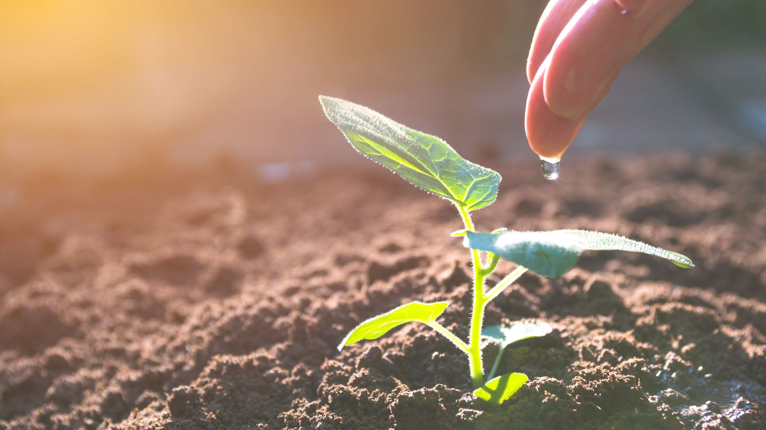
Results
Sunlight is a critical factor for photosynthetic organisms, such as plants, algae, and some bacteria, which use the energy from the light to convert carbon dioxide and water into oxygen and organic compounds. This leads to an increase in biomass and primary productivity, temperature increase, changes in metabolism, growth rates, and behavior, as well as changes in nutrient cycling and community structure.

Slide 9
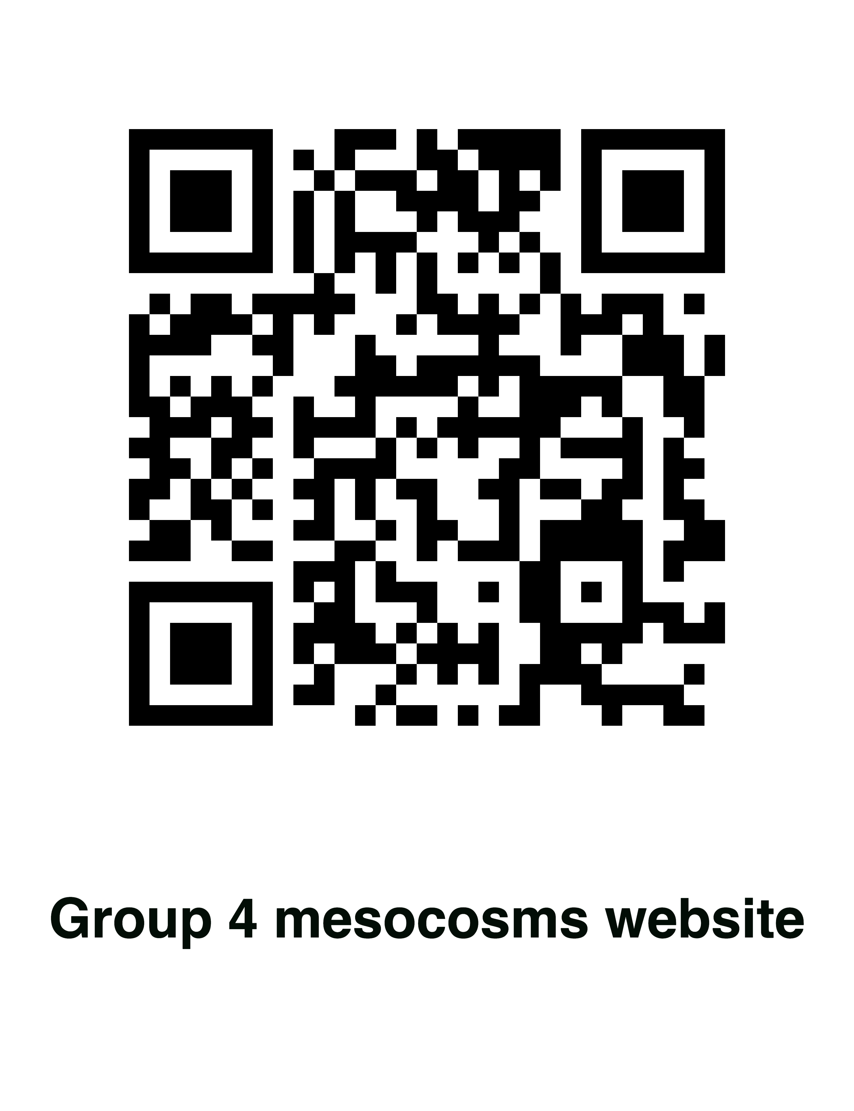
Our website
Our website can be accessed through the bar code below:
We created a website using the HTML and CSS languages and published the website for public access. It features a breakdown of the experiment, and the full report, including all the data obtained, the conclusion ,and analysis of the results. It was done to incorporate computer science in the experiment

Slide 10
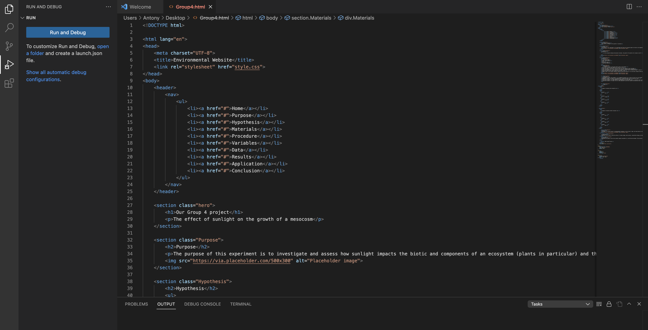

Slide 11
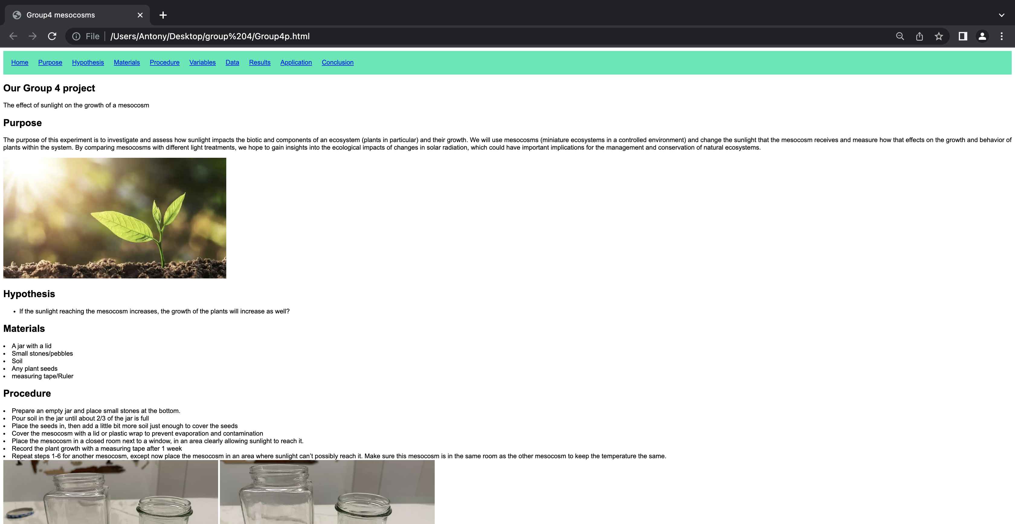

Slide 12
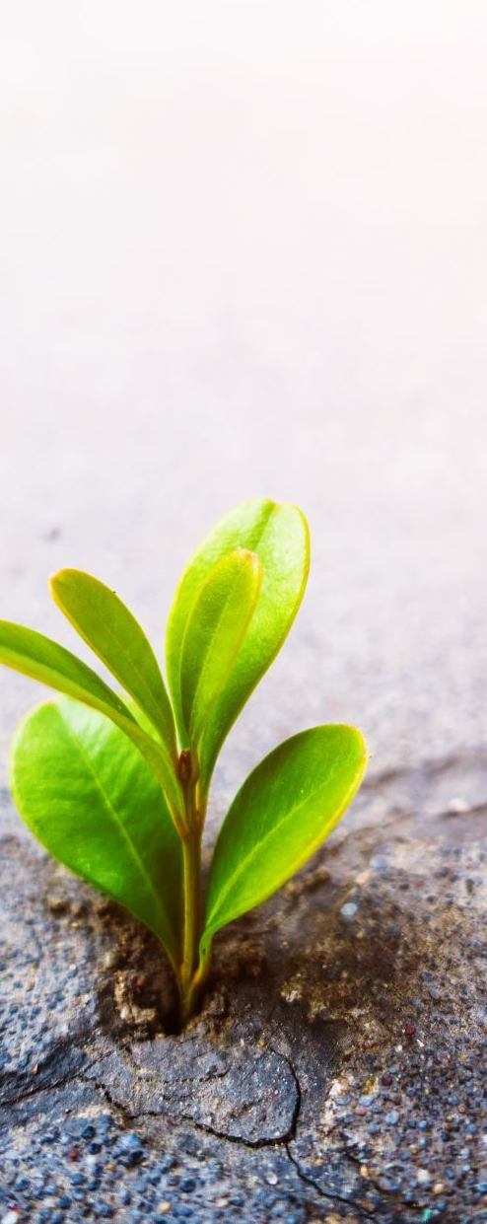
Conclusion
Mesocosms simulate complex ecosystems in a controlled environment.
Provide insights into how environmental stressors affect ecosystems.
Teach us about the relationships between organisms and their environment.
Cost-effective and practical alternative to studying ecosystems in the field.
Allow for mitigation measures to be put in place before potential disasters occur.
Essential tools in the study of ecology, conservation, and environmental science.

Slide 13
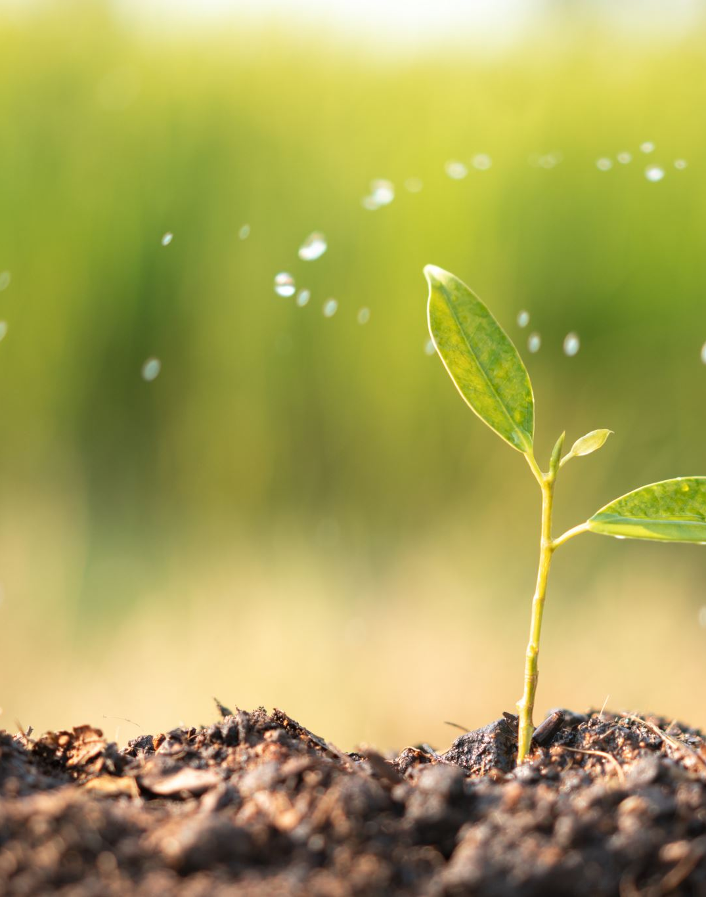
Application
Mesocosms can be used to study the effects of climate change, water quality, conservation biology, and agriculture. They can be used to simulate the effects of climate change on ecosystems, monitor water quality, reduce pollution, and protect endangered species. They can also be used to study agricultural practices and soil health and biodiversity.

Slide 14
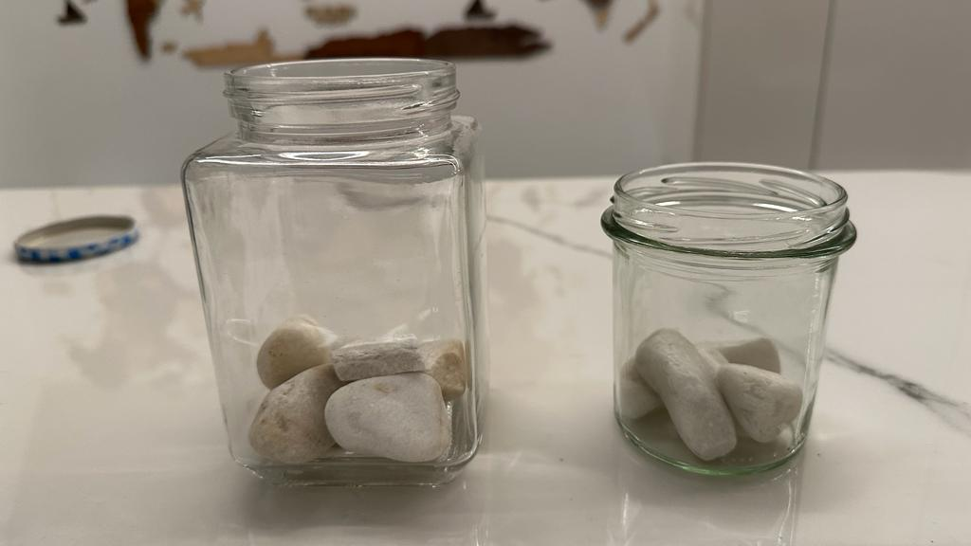
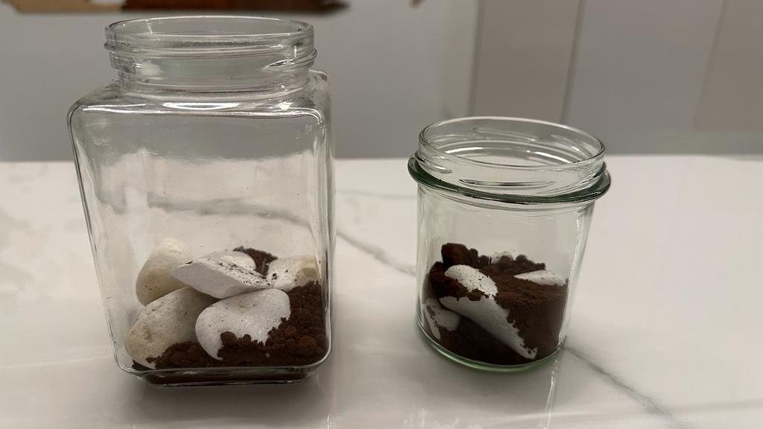
Images

Slide 15
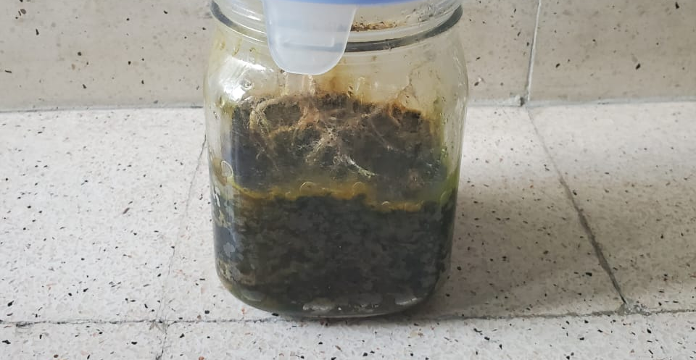

Slide 16
Bibliography:
Canadianschool.it. “What Is a Mesocosm?” Canadian School of Milan, 2016, https://www.canadianschool.it/news/?pid=8&nid=2&storyid=17. Accessed 16 April 2023.
Dealingwithib.wordpress.com. “Mesocosm.” Dealing with IB, 2015, https://dealingwithib.wordpress.com/mesocosm/. Accessed 16 April 2023.
Environmental Protection Authority. “Mesocosms.” Environmental Protection Authority, New Zealand Government, 19 Oct. 2017, https://www.epa.govt.nz/community-involvement/science-corner/mesocosms/. Accessed 16 April 2023.

Slide 17
Bibliography:
Hicks, L. “Design Process - Mesocosm.” Lhicks2015, 2015, https://lhicks2015.weebly.com/design-process.html. Accessed 16 April 2023.
IB Bio Ninja. “4.1 Species, Communities, and Ecosystems.” IB Bio Ninja, BioNinja, https://ib.bioninja.com.au/standard-level/topic-4-ecology/41-species-communities-and/mesocosms.html. Accessed 16 April 2023.
Mesocosm. “What Is a Mesocosm?” Mesocosm, University of Essex, https://mesocosm.org/about/what-is-a-mesocosm/. Accessed 16 April 2023.

